Slide 1
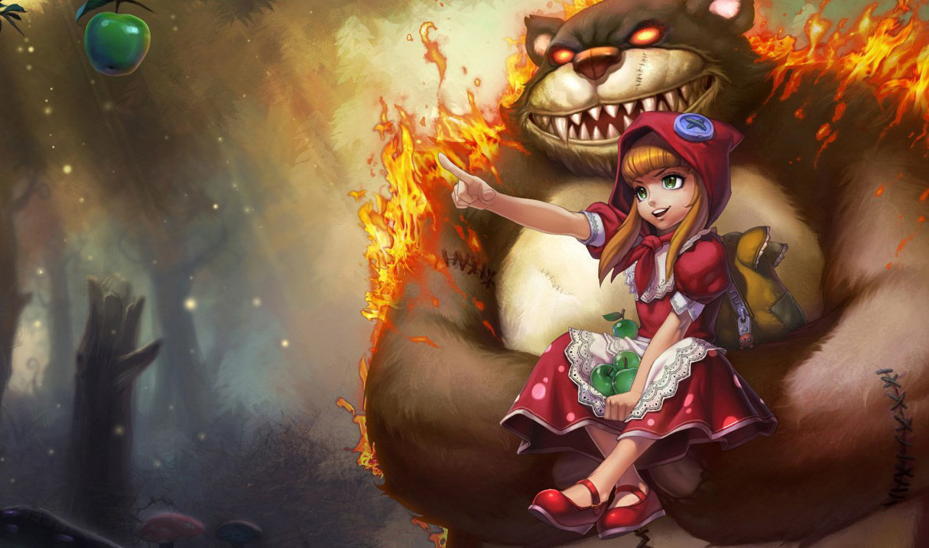
League of Legends Role Models
A Recommendation System for Skill Training and Study
By Gwen Rathgeber | Github | LinkedIn

Slide 2
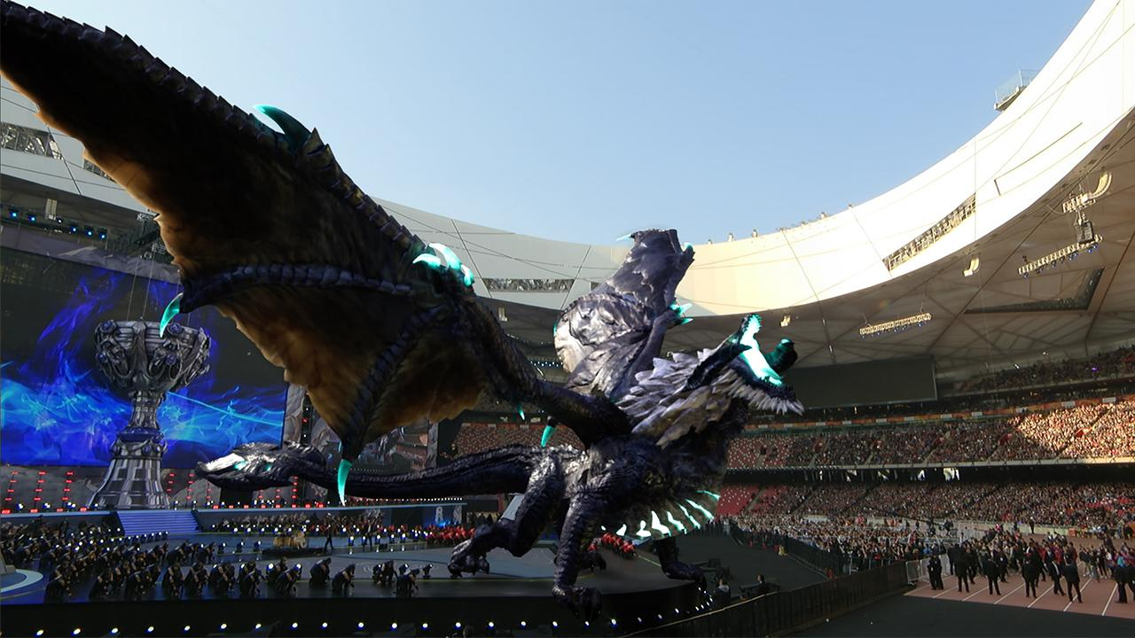
What is League of Legends?
Competitive 5v5 MOBA game launched in 2009
Playerbase around 115 million
2019 World Championship reached 44 million concurrent viewers
Known for a satisfying blend of strategy and technical skill
Highly complex game state

Slide 3
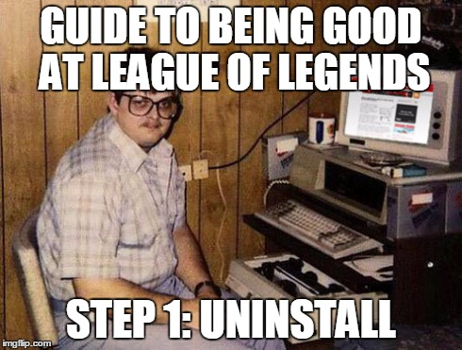
Who Plays League of Legends?
Known for being highly competitive and arguably addictive
Popular worldwide with teens and millennials
Games vary dramatically, making general knowledge and fundamental skills/decision-making critical to success
Players are highly motivated to study the game and improve their ladder rank to a degree that’s very notable

Slide 4
What’s a “Role Model”?
League was a leading driver of the rise of gaming streams
This was in part due to the desire of players to study the games of more-skilled players
We can match driven players with high-level counterparts that have similar gameplay patterns to enhance the quality of game review and self-study

Slide 5
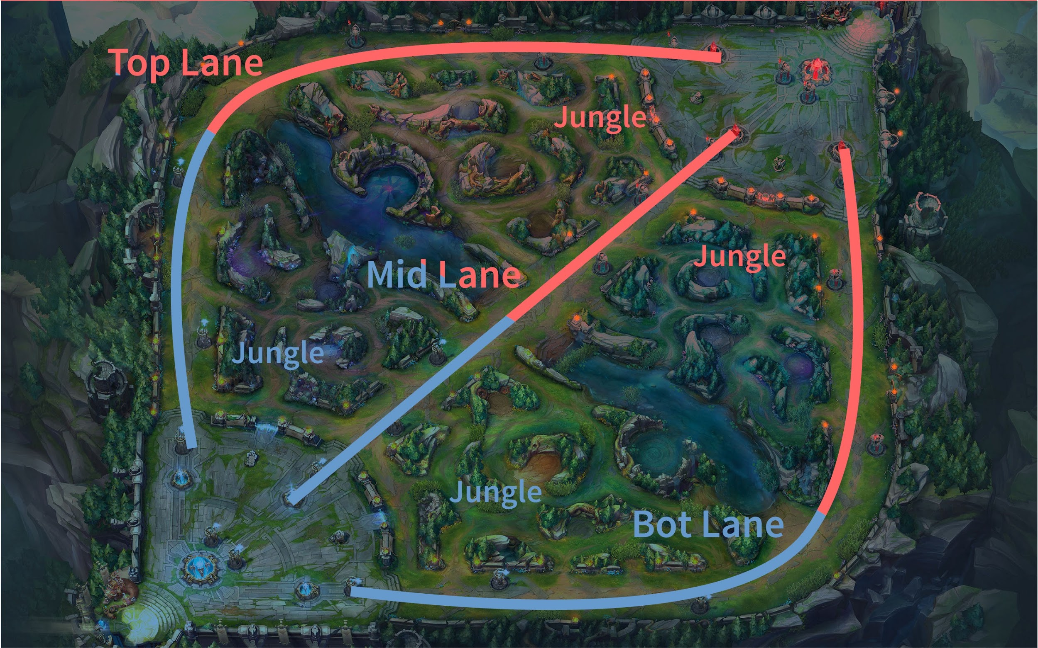
Basic Game Concepts, Pt. 1
Games last 15-45 minutes
In early stages, players lane against a matching opponent, competing for finite resources and map control (1-1-1-2)
In later stages, players group up for teamfights over neutral objectives which give massive power-ups
Game is won by destroying the enemy team’s nexus

Slide 6
Basic Game Concepts, Pt. 2
Gold and EXP are the main resources
EXP increases your level and unlocks new abilities for your champion (there are over 130 champions)
Gold can be used to purchase items, increasing your champion’s strength
Winning lane consists of earning more gold and EXP than your opponent(s)

Slide 7
Basic Game Concepts, Pt. 3
Later in the game, players fight for Baron Nashor and Dragons, which respawn on timers and give powerful buffs to your entire team
To safely control the map, players place temporary vision wards which remove fog of war

Slide 8
The Project
Pull gameplay data from the Riot Games API
2. Analyze the player’s recent games
3. Match the player with high-level Role Models

Slide 9
Fingerprinting a Player
Fighting and Aggression
-% of kills that are assisted by 0, 1, or more teammates
-Average % of team’s total damage delivered and taken
-Average % Kill Participation
-Share of kills which occur in each stage of the game
Vision and Objective Control
-Share of wards placed in each stage of the game
-Dragon and Baron Control
-Average % of team’s total objective damage
Laning Stats
-Average Gold and EXP lead/deficit on lane opponent
-Share of kills occurring in the first 10 minutes of the game
-% of wards placed in the first 10 minutes of the game

Slide 10
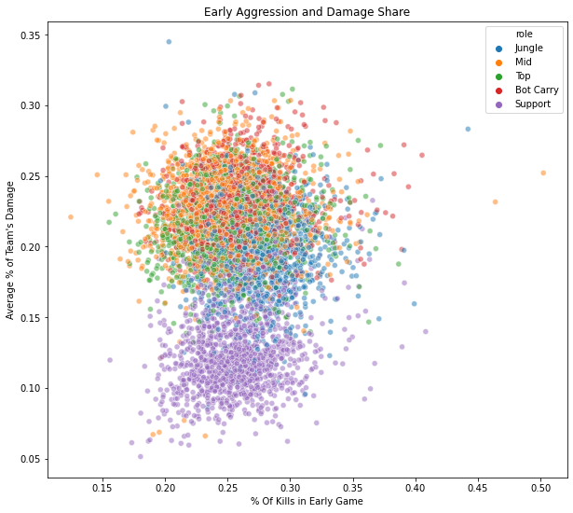
Final Model
Compresses up to 100 recent games for a player into a single row of statistics
There aren’t many distinctive groups in the data (except for Support players, who have distinctive ways of contributing to the team), so clustering is unlikely to tell us much
Scanned against ~7000 of the best players worldwide for the closest match across 21 metrics

Slide 11
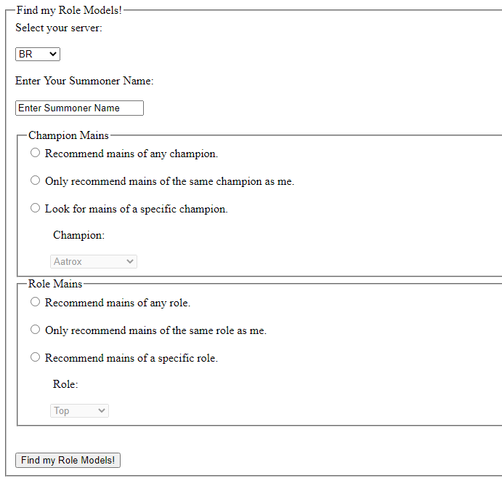
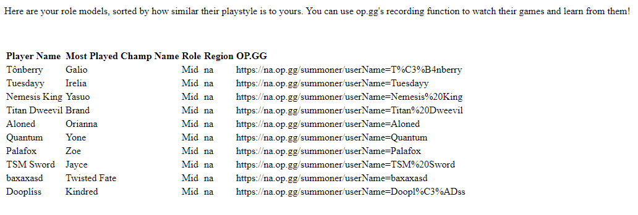
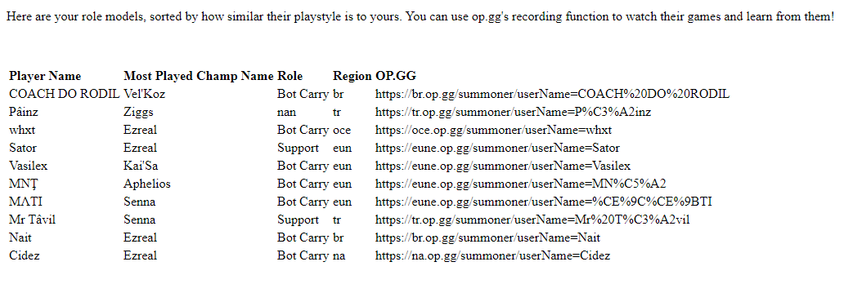
Flask App
Input:
Output:

Slide 12
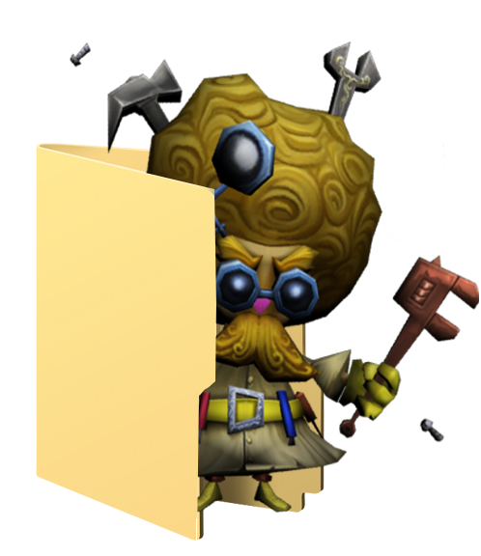
Future Work
Deploy Flask App on Heroku (Managing API Rate Limits across asynchronous users, add styling)
Add Champion Recommendation component: what champions are most similar to your playstyle?
Visualize similarity for the user to enhance sense of personalization and give feedback on playstyle

Slide 13

Thank You!
Any questions?
Special Thanks:
Uthgar @ Mobalytics.gg
By Gwen Rathgeber | Github | LinkedIn

